Slide 1
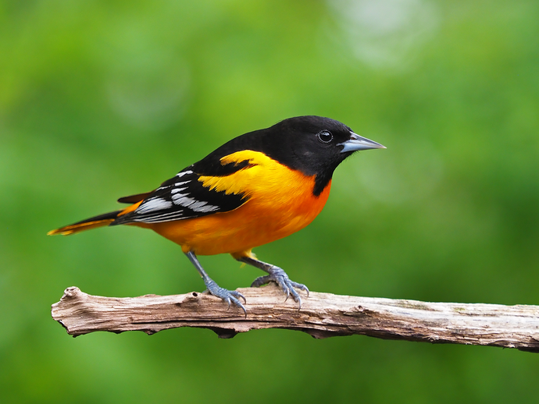
Bird Call Classification
Identifying species of bird by their call!

Slide 2
Background
Birds are generally very sensitive to habitat changes and because they are cooperative species it is easy to spot changes in their behavior
Through understanding their behavior changes we can better understand their respective general local ecology and better understand impacts from man-made change and climate change by proxy
Being able to classify individual species with high accuracy can save hundreds of hours of manual listening by bird experts

Slide 3
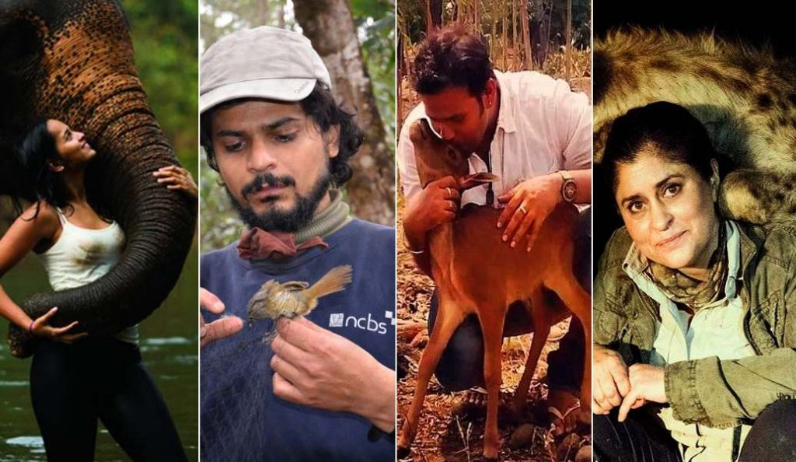
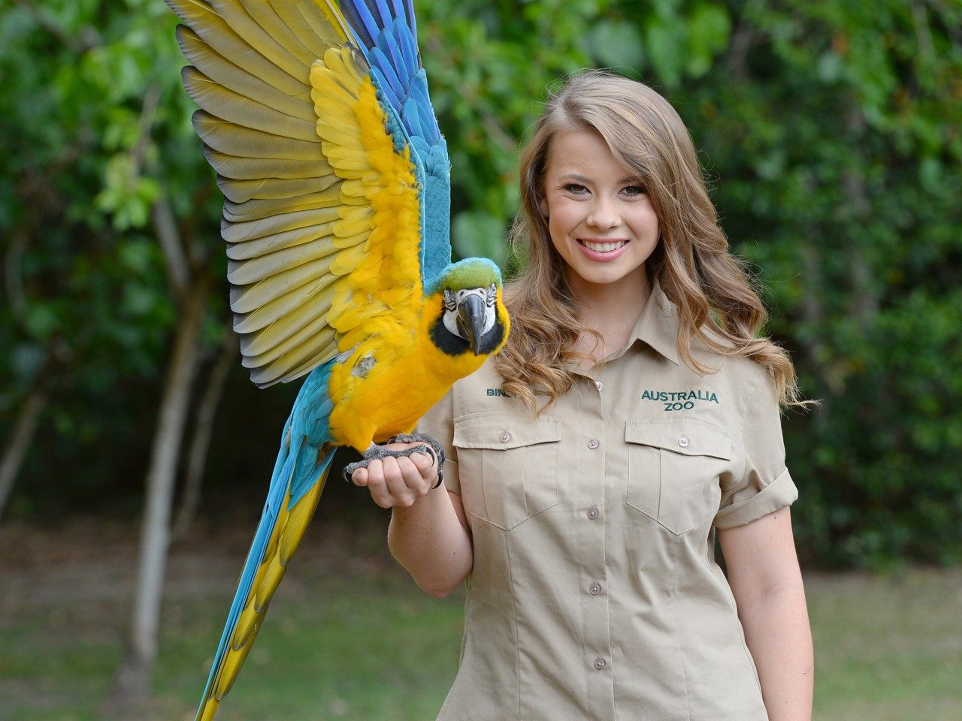
Who might care?
Conservationists...and all of us

Slide 4
Bird call + Metadata
Bird Songs
MP3 files of various duration
Metadata
Elevation
Date of recording
Location of recording
Recording quality rating
Duration
Call Speed
Accelerating, decelerating etc
Pitch
Accelerating, decelerating etc
Number of Notes

Slide 5
Data Summary
Bird call mp3 files captured between 06/02/1979 and 11/02/2019
264 individual specifies included
4275 mp3 files used to build classifying algorithm (limited to ~20% of total collection due to computational expense)
Metadata and mp3 connected via file_id
No missing data for labels

Slide 6
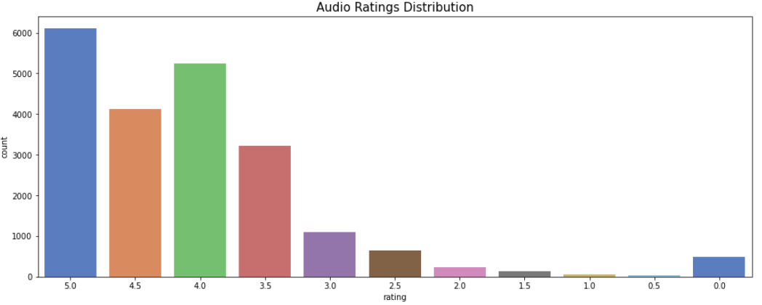
Metadata Exploration: Rating
Generally fairly clear, highly rated data (mostly 3.5 and up)
Small subset (~800) without a rating...no reason to try and impute

Slide 7
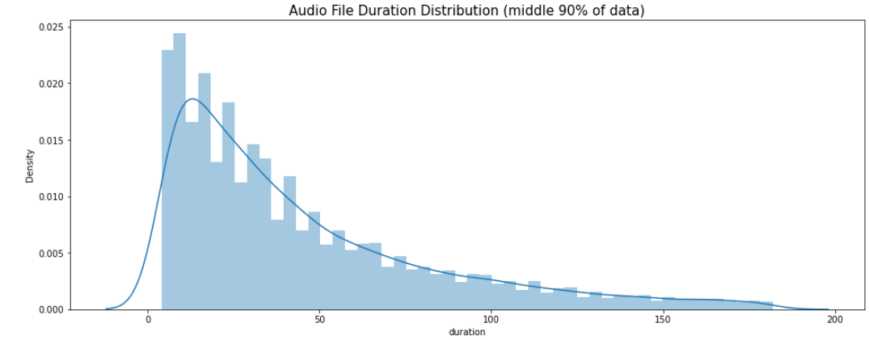
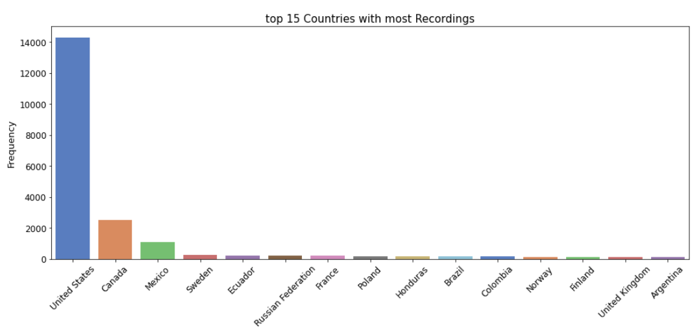
Metadata pt 2: duration and location
Heavily right-skewed, mostly <50 seconds
Most labeled data points collected in USA

Slide 8
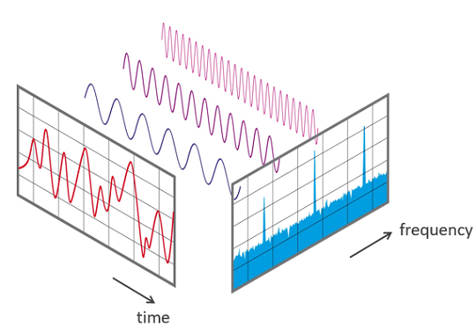
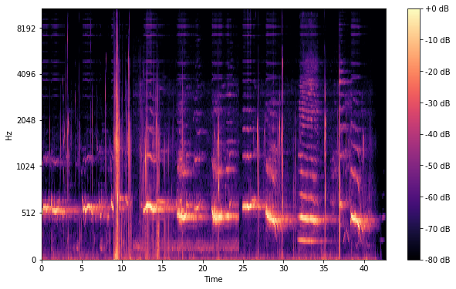
Model context 1: Signal -> Neural Network input
In order to leverage the predictive powers of a Neural Network, two transformations first had to take place
Fast Fourier Transform: This process maps audio signal from the Time domain to the Frequency Domain allowing it to serve as input for the next step...
Mel Spectrogram: This is an image of the FFT’s signal which is finally inputted into the NN

Slide 9
Model context 2: de-noising + dilation and power spectrogram to decibel
Weaker signals are eroded and stronger signals have been dilated via binary erosion and dilation, respectively (via scipy’s morphology library)
Power_to_db is then finally run before generating the mel spectrogram (both from the librosa library), finally readying our data for the NN.

Slide 10
Model: CNN (via transfer learning)
The Convolutional Neural Network was constructed in PyTorch
I leveraged ResNet34 (computer vision net) to predict the mel spec images with an added dropout layer to help reduce overfitting and a final output layer to flatten out results
Cross entropy loss was the cost and adam was the optimizer
Due to computational limitations of my machine, I only planned for using 20% of the training dataset and 5 Epochs. However even this would have taken way too long to train and so I eventually ran the full training set with 20 Epochs on a kaggle notebook

Slide 11
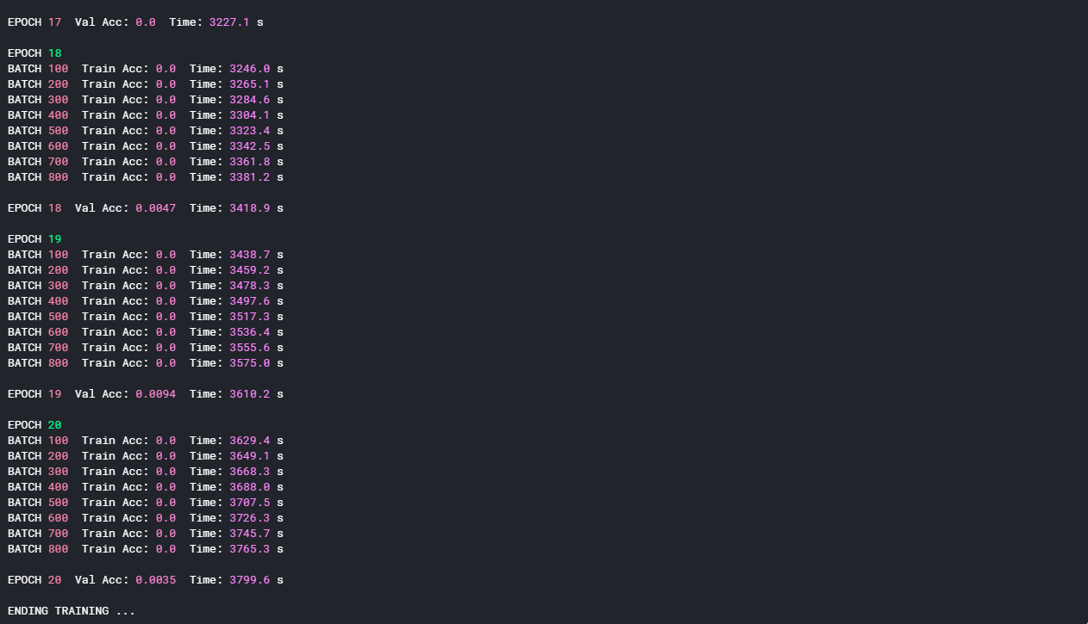
Model Results...Disappointing
Unfortunately, the results did not match the herculean efforts which went into it
After running 20 epochs on the full dataset the final validation accuracy fell between 0.35 - 0.9%. Slight improvement over just guessing at random (1/264)

Slide 12
Improvements for next time 1
Hyperparameter tuning: Since there were many other implementation details to mind for my first time building a CNN, I did not plan adequately for this little detail in the loops utilized for training in the kaggle notebook.
In the future, this will be something to more carefully consider before deciding on a model since the sheer scale and computational expense makes any fine-tuning a tremendous burden. It might end up that an optimized simple approach would’ve out-performed an un-optimized complex approach

Slide 13
Improvements for next time 2
Better function / class writing for PyTorch: This was my first time using this tool and the learning curve did not help with the slow progress in putting it all together. Lack of experience was unfortunately a big factor here but hopefully one that will be less of a problem next time around
Future Ideas:
Generating unique features with metadata -> new possible ideas for exploring future projects
Fine-tuning the transferred resnet with additional convolutions and max pooling layers to learn invariances unique to mel spec images

